Slide 1
Paperless Ticketing Using Face Recognition for Metro Rail
Project Guide: Nayana P Bhaskar
Presented by,
Praseetha M Das
Tina Thomas
Treesa Rose
Sayeed A P

Slide 2
Contents
Introduction
Objective
Face Recognition
System Analysis
System Configuration
System Architecture
Modules
Conclusion

Slide 3
Introduction
Time and convenience have great importance in human life. We are trying to make metro rail ticketing system more efficient without paper. As face is one of the easiest ways to distinguish the individual identity of a person, we are planning to use Face recognition to implement a Paperless ticketing system.

Slide 4
Objective
To make Metro rail ticketing system more efficient and convenient without paper.

Slide 5
Face Recognition
A biometric is a biometric software application capable of uniquely identifying or verifying a person by comparing and analyzing pattern based on the persons facial contours.

Slide 6
SYSTEM ANALYSIS

Slide 7
Existing System
Paper tickets with barcodes are used as entry
And exit pass for metro rail transport.
Drawbacks:-
Inconvenience for safe keeping of paper tickets
Wastage of paper
Time consuming

Slide 8
Proposed System
A paperless ticketing system using face recognition by identifying and analyzing the shape of a person’s face. Each face has approximately 80 unique nodal points which distinguishes one from another.
Advantages:-
Convenient
Eco-friendly
Time saving

Slide 9
SYSTEM CONFIGURATION

Slide 10
Software Specification
OS : MS Windows7 or higher versions/ Ubuntu 14.04
Opencv
Python 3.7
Sqlite

Slide 11
Hardware Specification
Intel Core 2 Duo/Quad or higher and 64bit processor
Hard Disk capacity of 1- 4TB, 4 GB RAM or more
Input devices: keyboard, digital camera
Output device : computer monitor

Slide 12
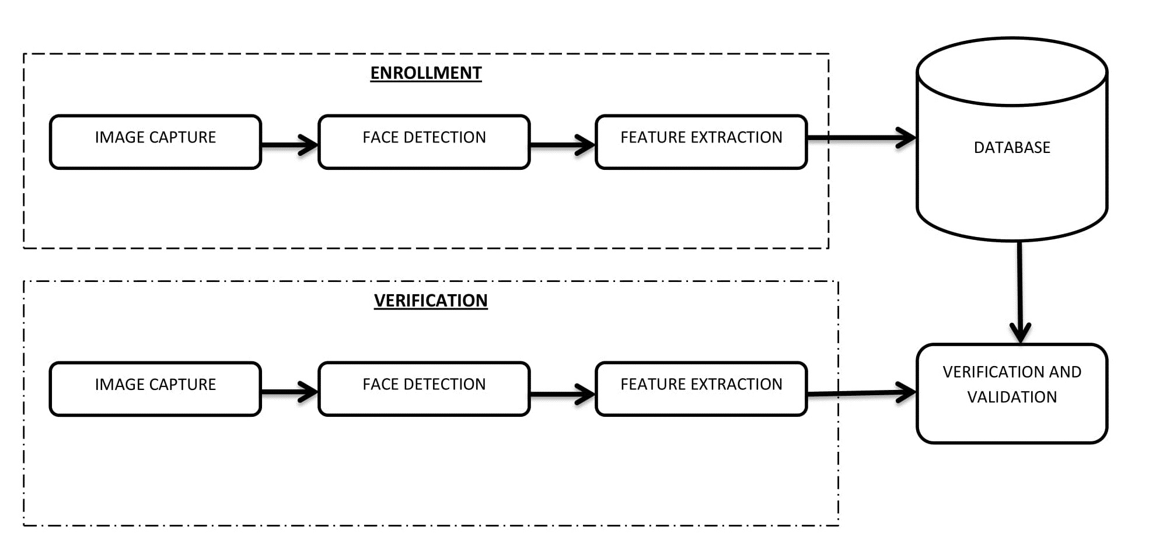
System Architecture

Slide 13
List Of Modules
Administrator
Station master
Entrance verification
Exit validation

Slide 14
Administrator
Station master management
Database management
Rules and regulations
Fare rate
Accounting

Slide 15
Station master
Ticket reservation
    Face capturing
    Details collection
        Name
        Contact details like phone number or mail id
        From station
        Destination
    Accounting update
Ticket cancellation
    Database deletion/update
    Accounting update

Slide 16
Entrance Verification
Face recognition
verification
Time stamp allocation
Ticket activation

Slide 17
Exit Validation
Face recognition
Verification
Time stamp checking
Ticket deactivation

Slide 18
STATION MASTER MODULE

Slide 19
Station Master Functions
Station Validation
  Station Username
  Password
Ticketing
  Name
  Destination
  Fare calculation
  Face Detection, Capture & Storing

Slide 20
Station Table
FIELD | TYPE | NULL | KEY | DEFAULT | EXTRA
station_id | Int(5) | No | PRIMARY | None
station_name | varchar(20) | No |  | None
user_name | varchar(20) | No |  | None
password | varchar(20) | No |  | None

Slide 21
Passenger Table
FIELD | TYPE | NULL | KEY | DEFAULT | EXTRA
passenger_id | int(5) | No | PRIMARY | None | AUTO_INCREMENT
name | varchar(20) | No |  | None
from_station | int(5) | No |  | None
to_station | int(5) | No |  | None
date | datetime | No |  | None
status | int(5) | No |  | None

Slide 22
CODE SNIPPET

Slide 23
Database Connection
import mysql.connector
mydb = mysql.connector.connect(host="localhost",user="root",passwd="",database="python")
mycursor = mydb.cursor()
Station Validation
sql3 = "SELECT * FROM station WHERE user_name = %s and password=%s"
login = (user_name,password,)
mycursor.execute(sql3, login)
myresult = mycursor.fetchall()
# validate station master

Slide 24
Cont…
Ticket Activation
sql = "INSERT INTO passenger(name, fromstation,tostation) VALUES (%s, %s, %s)"
val = (face_name, station_id, to_station)
mycursor.execute(sql, val)
mydb.commit()

Slide 25
Image Capture
import cv2
cam = cv2.VideoCapture(0)
face_detector = cv2.CascadeClassifier('haarcascade_frontalface_default.xml')
while(True):
ret, img = cam.read()
gray = cv2.cvtColor(img, cv2.COLOR_BGR2GRAY)
faces = face_detector.detectMultiScale(gray, 1.3, 5)

Slide 26
Cont…
for (x,y,w,h) in faces:
cv2.rectangle(img, (x,y), (x+w,y+h), (255,0,0), 2)
count += 1
cv2.imwrite(“path", gray[y:y+h,x:x+w])
cv2.imshow('image', img)
k = cv2.waitKey(100) & 0xff
if k == 27:
break
elif count >= 30:
break
cam.release()
cv2.destroyAllWindows()

Slide 27
Conclusion
We are trying to create a convenient and time saving ticketing model for metro rail ticketing with the help of face recognition technique.

Slide 28
THANK YOU...!

